Slide 1
Evolving HIV epidemics: the urgent need to refocus on key populations
Tim Brown, East-West Center
Time to focus: Doing things better and differently for key populations
WHO Satellite, AIDS 2018, Amsterdam

Slide 2
Roadmap: exploring the impacts of key populations on today’s HIV epidemics
Look at evolution in concentrated settings: perceived and real
Examine the natural history of key population epidemics and its “interpretation”
Look at key population’s relevance in generalized epidemic settings

Slide 3
What’s happening with HIV epidemics in concentrated settings?

Slide 4
The press, advocates and policymakers often frame HIV as growing “heterosexual” or “general population” epidemics…

Slide 5
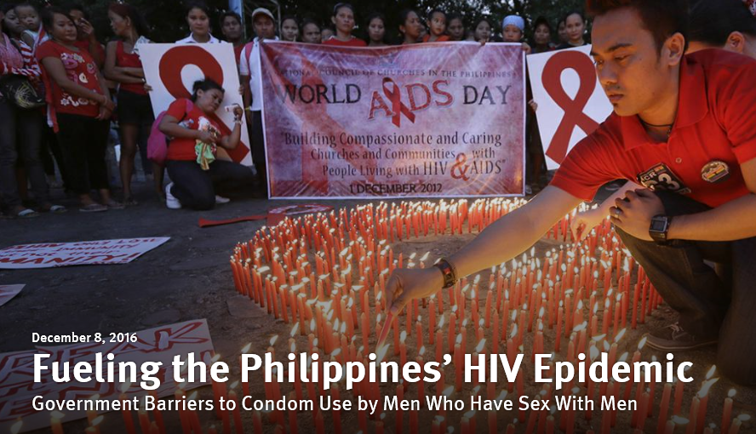
Sanchita Sharma,
Jan 19, 2018
Michel Sidibé,
Apr 18, 2018
Human Rights Watch

Slide 6
…but epidemiologists & technical partners keep the emphasis on key populations

Slide 7
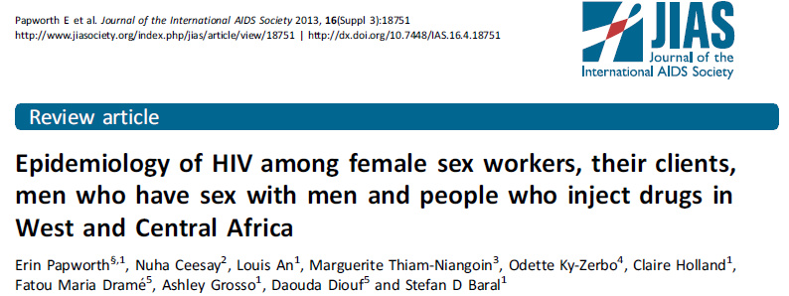
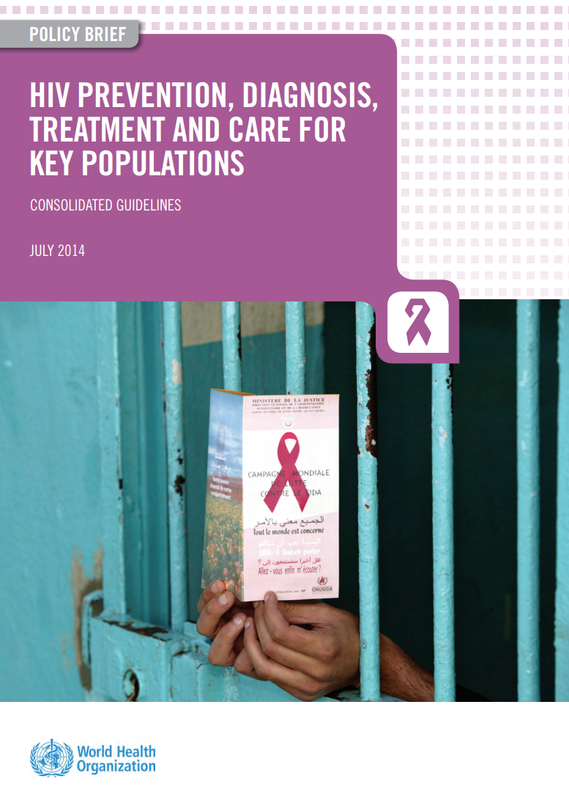

Slide 8
Why the differing perceptions?
We promoted a concentrated to generalized paradigm in the past
The “general population” is an easier “sell”
Prevention success has lowered prevalence in key populations
Long running concentrated epidemics do have more heterosexuals with HIV
Epidemics vary from country to country and even within countries

Slide 9
Which view, if not both, is correct and what is the path forward?
The natural history of HIV epidemics in concentrated settings

Slide 10
Let’s explore HIV in a diverse region: Asia
Use the AIDS Epidemic Model
Contains critical key populations
Simulates transmission thru risk behaviors
Have a full set of national models
11 countries
Diverse epidemics
FSW/ISW
MSM/MSW
Client
PWID(M/F)
Low or no risk
male
TG
Low or no risk
female
Countries: Bangladesh, Indonesia, Cambodia, Lao PDR, Myanmar, Malaysia, Nepal, the Philippines, Pakistan, Thailand and Viet Nam

Slide 11
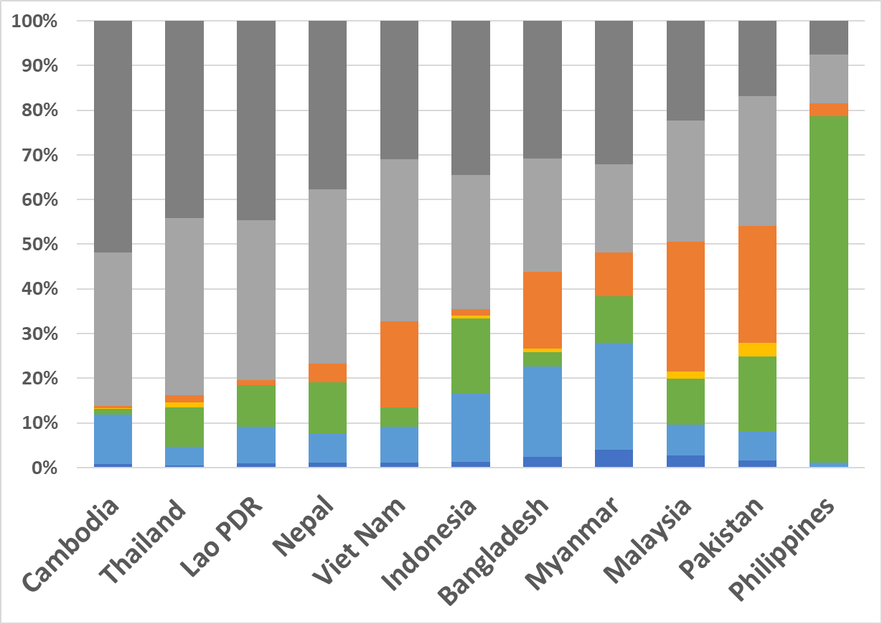
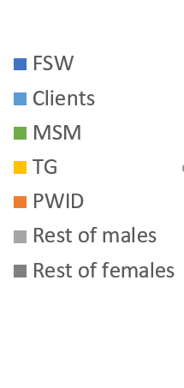
The current situation: prevalent HIV Distribution of current infections in 2017
18% to 86%
outside KPs

Slide 12
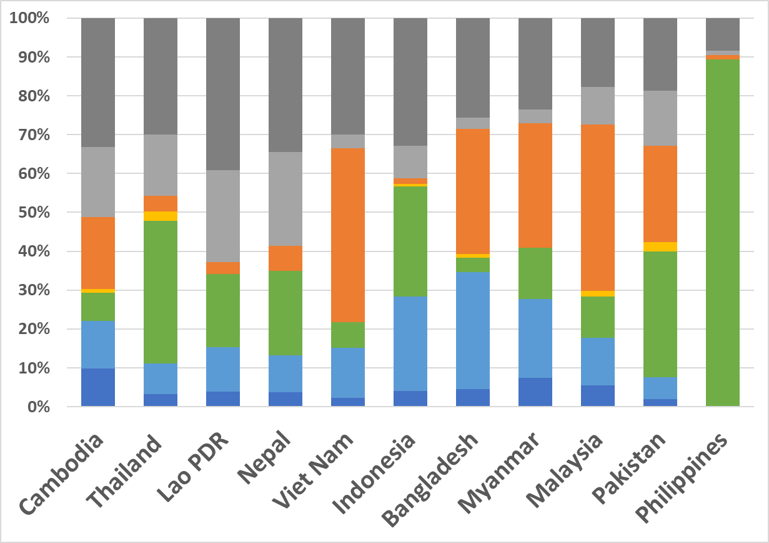
The current situation: new infections Distribution of new infections in 2017
10% to 62%
outside KPs

Slide 13
Observations
Great diversity
Timing and severity of epidemics varies substantially
Contributions of key populations can be very different
Older, more severe epidemics have more HIV infections among “general population”
Prevalent infections predominantly here
New infections still heavily among key populations

Slide 14
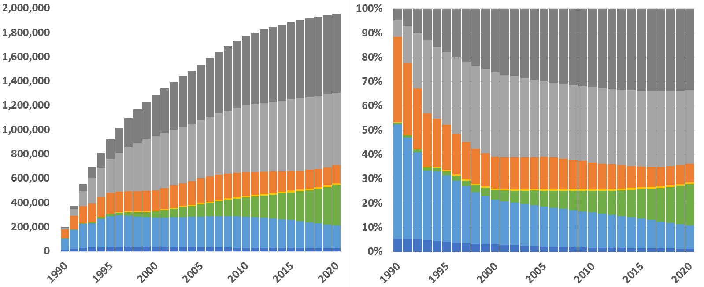
Current infections: all countries evolution
By 2018, 65% of current infections are outside of key populations

Slide 15
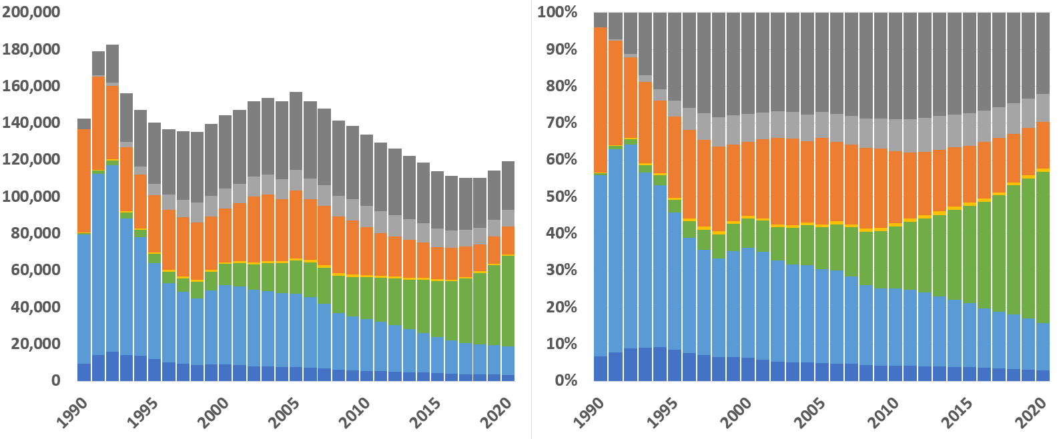
Yearly new infections: all countries evolution
…but only 33% of new infections in 2018 are outside of key populations
Also, the number of new infections in non-KP women is 3x that of men

Slide 16
The concentrated epidemic conundrums
With 2/3rd of new infections in key populations, how are 2/3rd of current infections outside them?
Why does the proportion of current infections outside key pops increase with epidemic age?
Are the epidemics “going generalized”?
Why is number of new infections among women outside key pops 3 times than for men?
Notes:
Understanding the answer to these questions will help us understand: 1) how these epidemics evolve and 2) lead to an understanding of all the ways in which key populations contribute to epidemics.

Slide 17
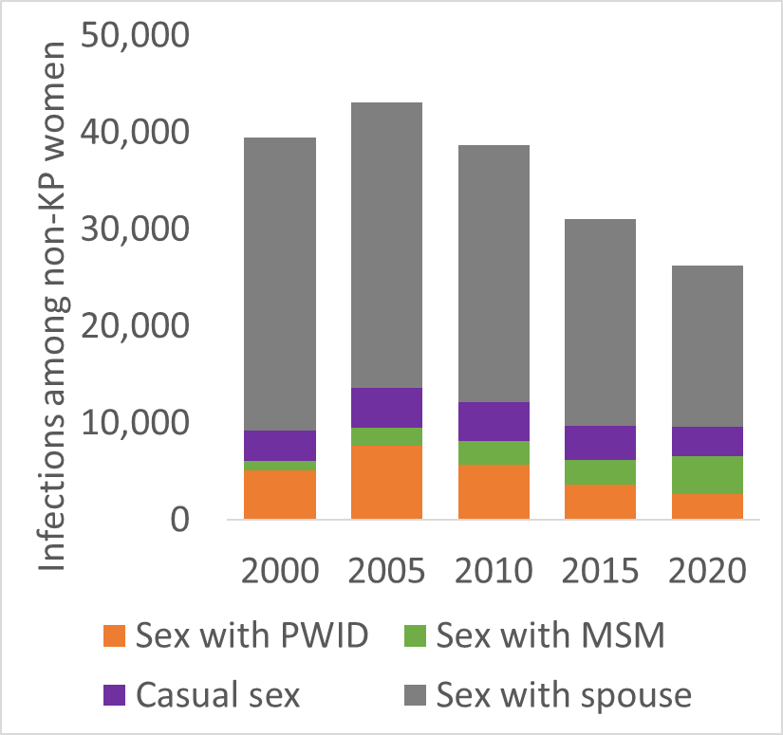
Key populations & HIV epidemic dynamics
Direct transmission among key population members
MSM & TG
Anal sex high efficiency
PWID
High frequency needle sharing
FSW & clients
High STI levels
Members of key populations have intimate partners
Contribution of casual sex: 2.5%

Slide 18
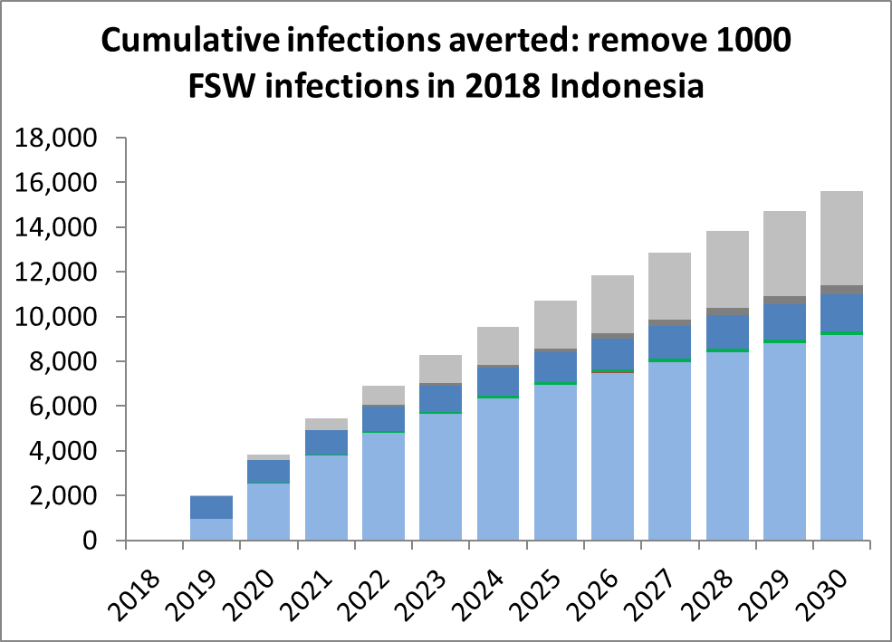
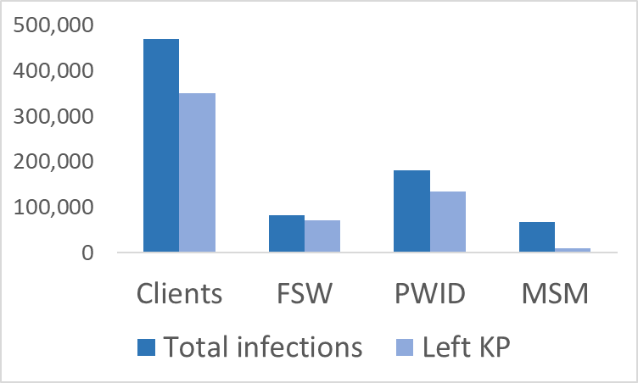
Key populations & HIV epidemic dynamics
Key populations not closed
People move in and out of them, i.e., turnover
Can contract HIV today, leave the key population and infect future intimate partners
Downstream infections
Protecting KPs today prevents downstream transmission
Thailand thru 2017
91% of infections of non-KP
women from ex-KP men

Slide 19
We can now answer those questions
With 2/3rd of new infections in key populations, how are 2/3rd of current infections outside them?
Infections outside of KPs largely from: 1) former KP members; 2) contracting HIV from current or ex-KP
Why does the proportion of current infections outside key pops increase with epidemic age?
Turnover accumulates over time & spousal transmission is slower, thus effects grow over time
Why is number of new infections among women outside key pops 3 times than for men?
Most of KPs turning over are men. 24 million clients, 740,000 PWID, 4 million MSM, but only 1 million FSW
Notes:
Understanding the answer to these questions will help us understand: 1) how these epidemics evolve and 2) lead to an understanding of all the ways in which key populations contribute to epidemics.

Slide 20
Implications for programming
Continued focus on key population combination prevention is central to slowing today’s concentrated epidemics
Most infections outside of key pops in these epidemics result from earlier risk in key pops
Don’t divert resources to “general population” efforts
Expanded programs for spouses and partners of current / former KP members urgently needed

Slide 21
Unless there is substantial heterosexual risk outside of sex work, concentrated epidemics will stay concentrated in nature, so maintaining key population focus is critical

Slide 22
Does this apply beyond Asia?

Slide 23
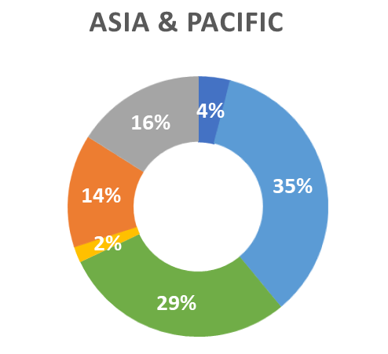
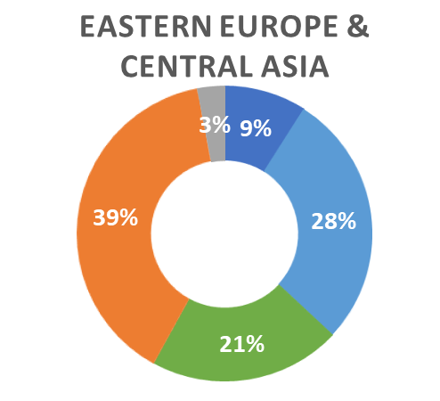
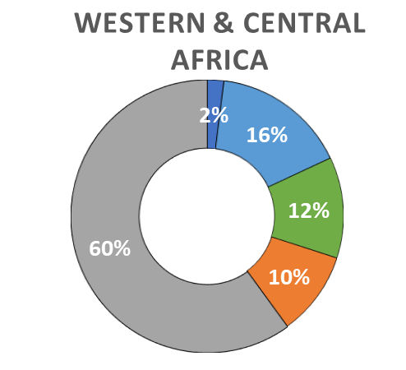
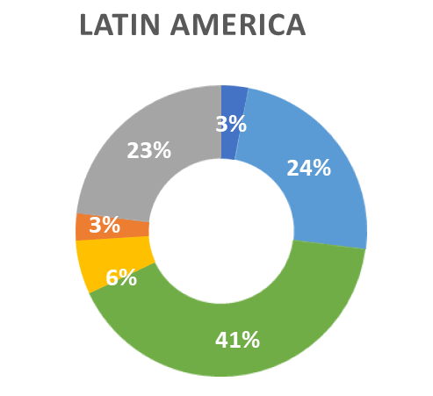
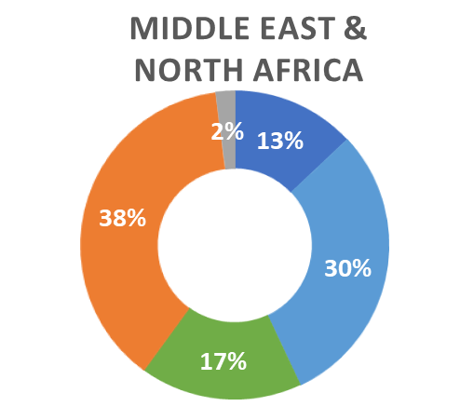
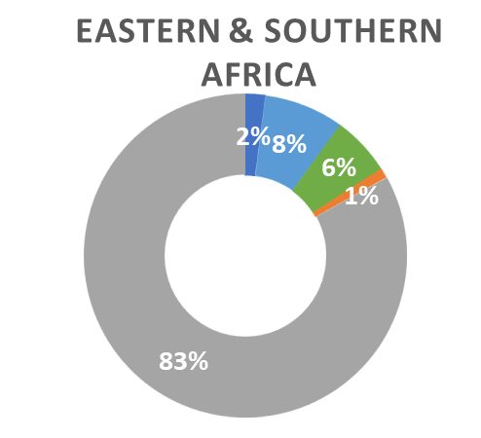
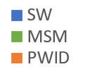
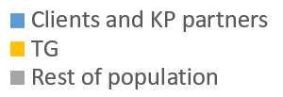
New infections by key population 2017
Source: Miles to Go 2018, UNAIDS
Notes:
47 of global new infections are now among key populations, which dominate transmission in all regions but Africa. As data has improved in West & Central Africa the proportion among key populations has increased.

Slide 24
What about key population epidemics in generalized settings?
They do contribute to transmission, but the amount is less well characterized

Slide 25
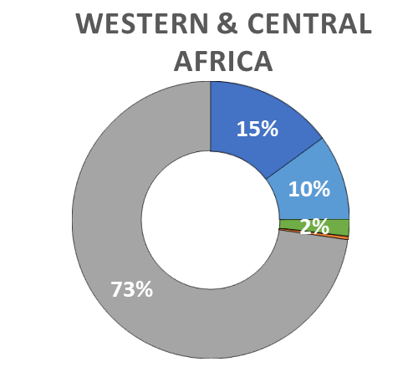
As data has improved, the key population proportion in WCA has increased
2014 estimate
2017 estimate
Source: UNAIDS

Slide 26
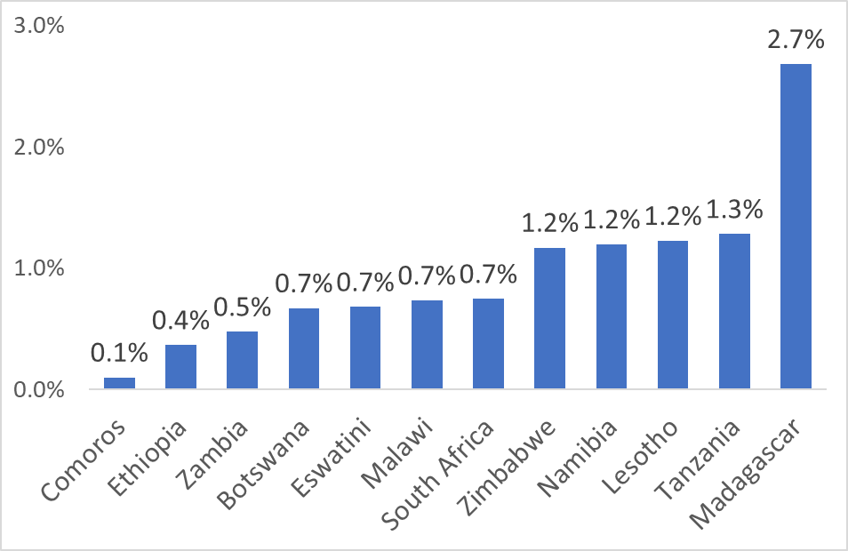
FSW in ESA as percent of 15-49 women
Source: UNAIDS Data 2018

Slide 27
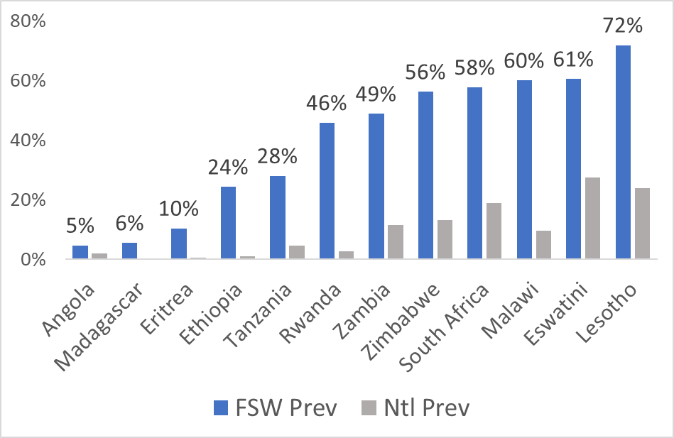
FSW in ESA prevalence vs national
2 to 26 times as high
Source: UNAIDS Data 2018

Slide 28
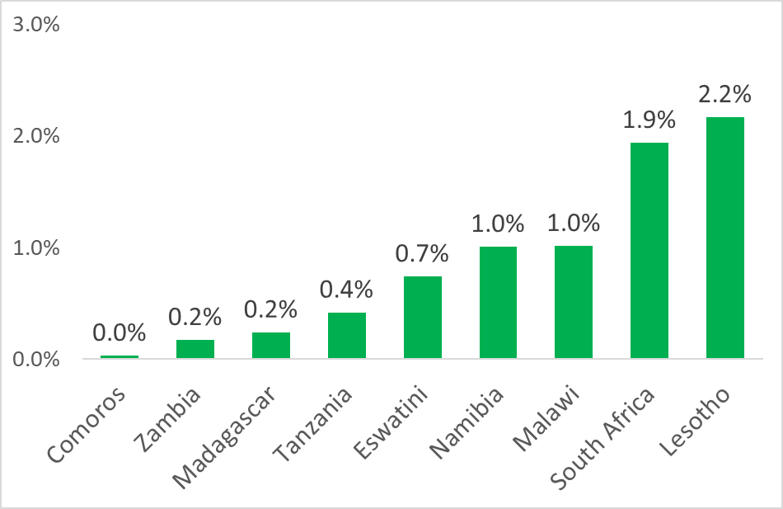
MSM in ESA as percent of 15-49 men
Source: UNAIDS Data 2018

Slide 29
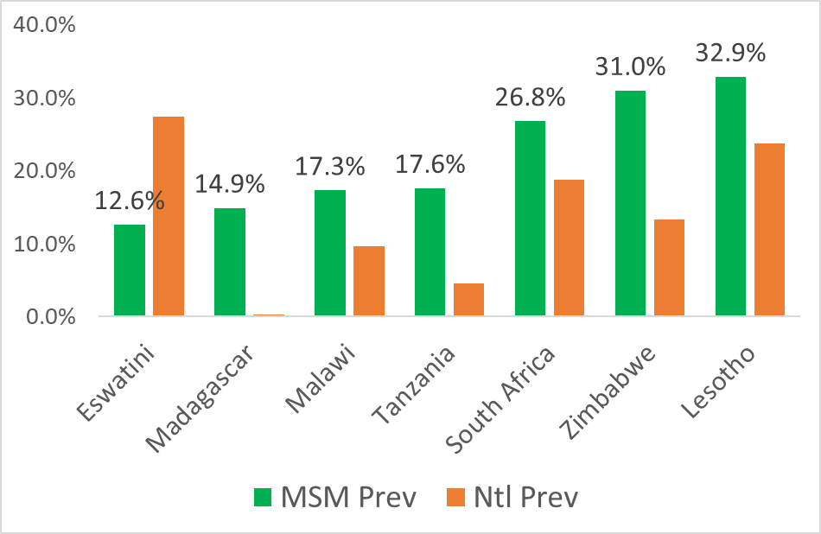
MSM in ESA prevalence vs national
0.5 to 58 times as high
Source: UNAIDS Data 2018

Slide 30
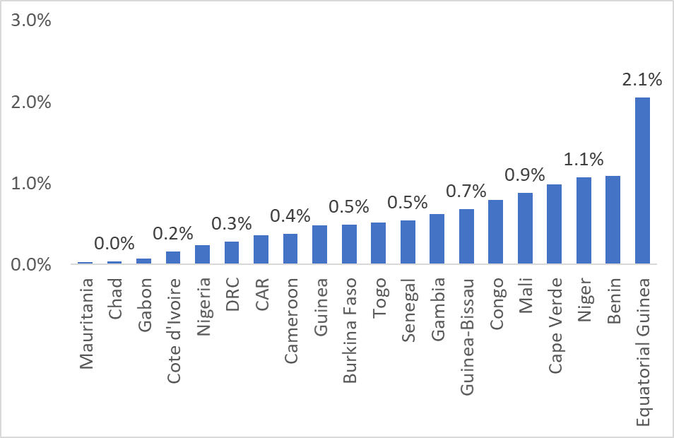
FSW in WCA as percent of 15-49 women
Source: UNAIDS Data 2018

Slide 31
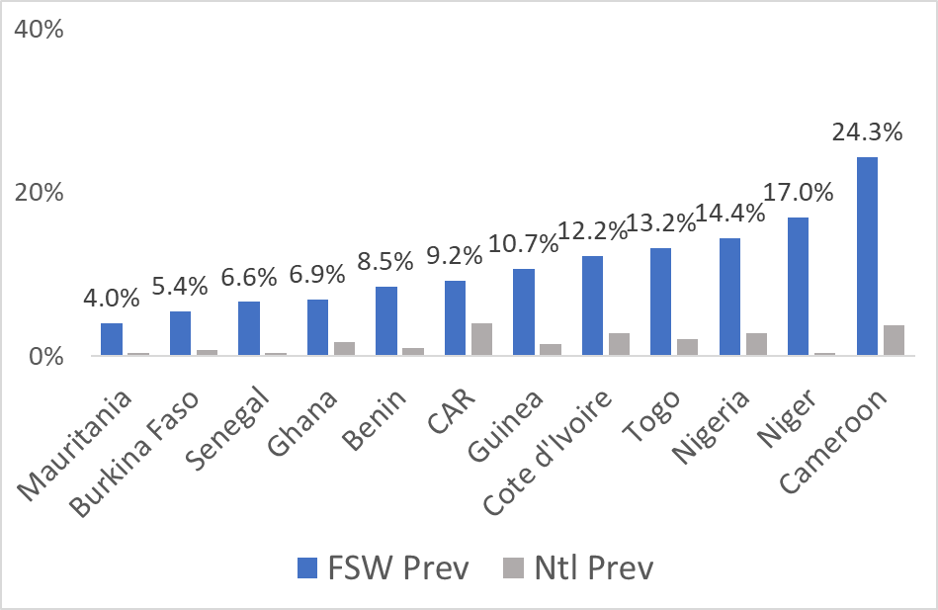
FSW in WCA prevalence vs national
2 to 54 times as high
Source: UNAIDS Data 2018

Slide 32
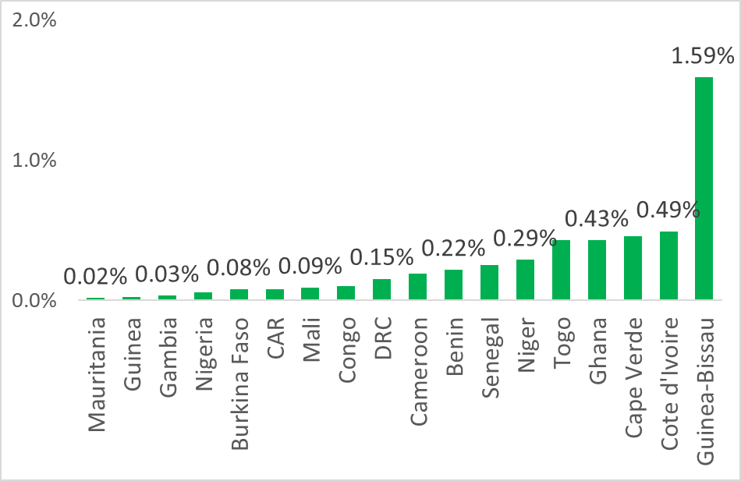
MSM in WCA as percent of 15-49 men
Source: UNAIDS Data 2018

Slide 33
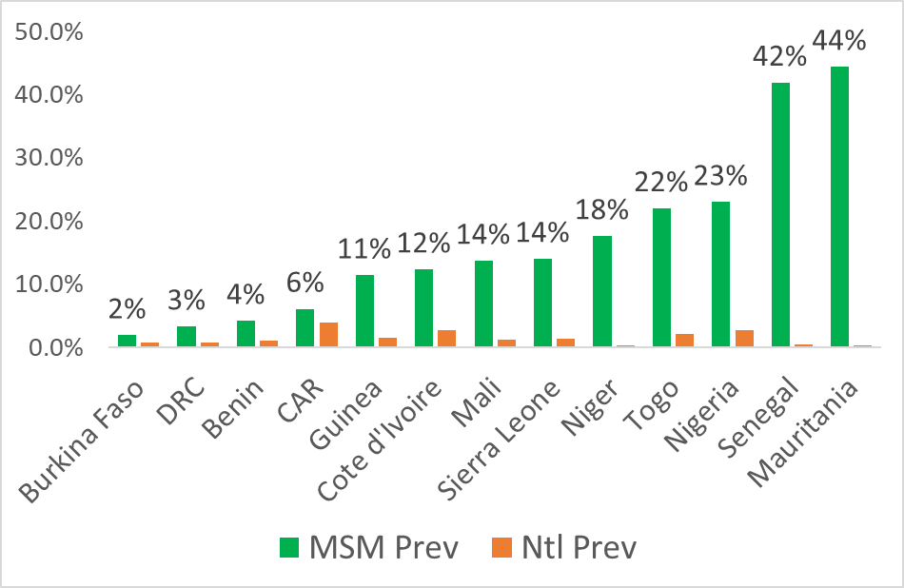
MSM in WCA prevalence vs national
1.5 to 128 times as high
Source: UNAIDS Data 2018

Slide 34
So what can we say about key population epidemics in generalized settings?
They’re real
Prevalence high – sometimes, higher than elsewhere
The actual contribution may be underestimated
Population sizes for MSM often quite low
Observed prevalence is quite high
Many countries in Africa still lack good data
They’re poorly addressed & under resourced

Slide 35
Models in Africa continue to improve in incorporating & addressing key populations
Modes of Transmission model has given way to the Incidence Patterns Model and Goals work
The impacts of sex work may be underestimated
Steen, Hontelez et al., AIDS 2014 looked at Kisumu, Kenya
Included 3 activity classes for FSW, e.g., professional, occasional and transactional
Found benefits similar to what is seen in Asia
MSM transmission may have larger impacts
Volz, Ndembi et al., Virus Evolution explored phylodynamic model for Abuja, Nigeria
Found annual incidence of 7.9% among MSM
Population attributable fraction to reproductive age women 9.1%

Slide 36
Closing remarks
Key populations globally need to remain at the core of the response
Major gains in AP, LAC, EECA and MENA will come here
Increased key population focus can benefit Africa greatly
Lack of data has often driven a lack of response
Reinforced by stigma, discrimination & legal/social sanctions
Key population programs at scale are largely successful
Modeling needs to make a more concerted effort to “get it right” in estimating impacts & benefits of KP programs

Slide 37
Acknowledgements
The AEM country teams in:
Bangladesh, Indonesia, Cambodia, Lao PDR, Myanmar, Malaysia, Nepal, the Philippines, Pakistan, Thailand and Viet Nam
Those supporting AEM development & application:
WHO SEARO
Global Fund
Gates Foundation through Avenir Health
UNAIDS
USAID, FHI and World Bank
The AEM Development team:
Wiwat Peerapatanapokin, Robert Puckett, Nalyn Siripong & Tim Brown

Slide 38
Old 2014 version of MOT analyses

Slide 39
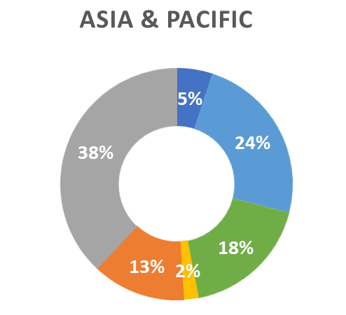
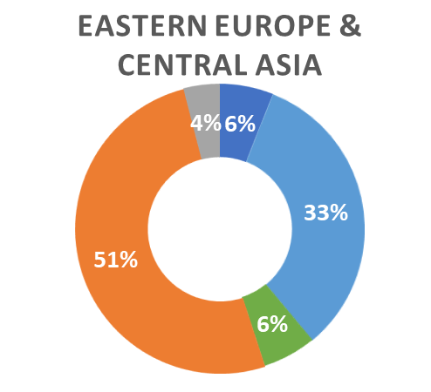
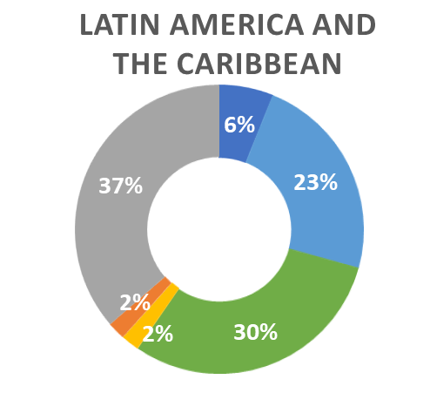
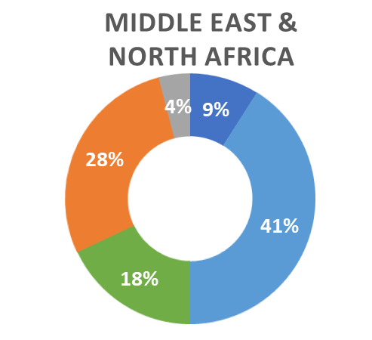
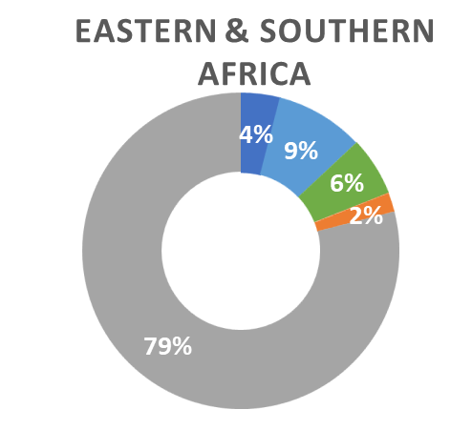
New infections by key population 2014
Source: AIDS by the numbers 2016, UNAIDS

